Slide 1
AudioTrack to AudioFlinger and Mix process and HAL

Slide 2
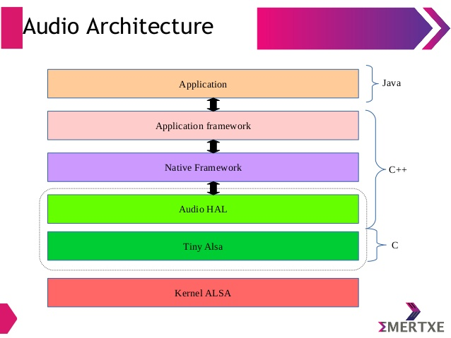

Slide 3
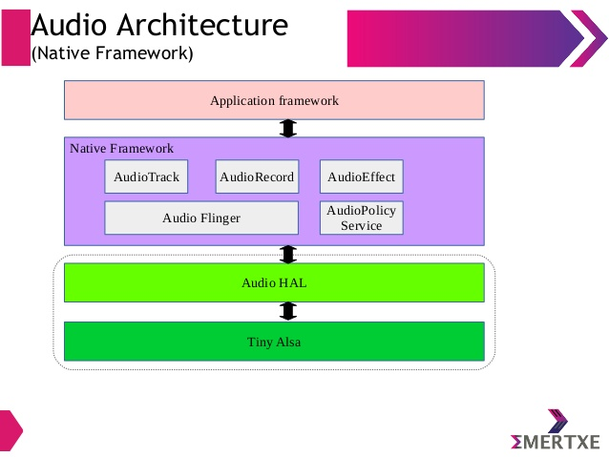

Slide 4
MediaPlayer and AudioTrack can be used to play sounds, both of which provide Java APIs for application developers
MediaPlayer class can be used to control playback of audio/video files and streams
The AudioTrack class manages and plays a single audio resource for Java applications.
It allows streaming of PCM audio buffers to the audio sink for playback.
This is achieved by "pushing" the data to the AudioTrack object using one of the write(byte[], int, int), write(short[], int, int), and write(float[], int, int, int) methods.
The difference between the two is that MediaPlayer can play audio sources in multiple formats, such as mp3, flac, wma, ogg, wav, etc., while AudioTrack can only play the decoded PCM data stream.

Slide 5
AudioTrack Java API
MODE_STATIC : The application process pays the playback data to AudioTrack in one time,
which is suitable for scenarios with small data volume and high latency requirements.
MODE_STREAM : The process needs to continuously call write() to write data to the FIFO,
and may encounter blocking when writing data. (Wait for AudioFlinger::PlaybackThread to consume data before), basically applicable to all audio scenes

Slide 6
AudioTrack Java API audio stream type:
STREAM_VOICE_CALL : Telephone voice
STREAM_SYSTEM : System sound
STREAM_RING : Ringing sounds, such as ringtones, ringtones, etc.
STREAM_MUSIC : Music sound
STREAM_ALARM : Warning tone
STREAM_NOTIFICATION : Notification tone
STREAM_DTMF : DTMF tone (dial button tone)

Slide 7
AudioTrack Native API output identification
(AUDIO_OUTPUT_FLAG)
1. AUDIO_OUTPUT_FLAG_DIRECT : It means that the audio stream is directly output to the audio device,
no software mixing is required,
and it is generally used for the sound output of the HDMI device.
2. AUDIO_OUTPUT_FLAG_PRIMARY : Indicates that the audio stream needs to be output to the
main output device, generally used for ringtone sounds.
3. AUDIO_OUTPUT_FLAG_FAST : Indicates that the audio stream needs to be quickly output to an
audio device, and is generally used in scenes with high latency
requirements such as key sounds and game background sound.

Slide 8
AUDIO_OUTPUT_FLAG
4. AUDIO_OUTPUT_FLAG_DEEP_BUFFER : It indicates that the audio stream output can accept a large delay, and is generally used in scenarios where music and video playback do not require high delay.
5. AUDIO_OUTPUT_FLAG_COMPRESS_OFFLOAD :Indicates that the audio stream has not been decoded by software and needs to be output to a hardware decoder, which is decoded by the hardware decoder

Slide 9
Audio policy service
Audio policy service is a service responsible for all actions that require a policy decision to be made first, such as opening a new I/O audio stream, re-routing after a change, and stream volume management. This audio policy source code is located in the below path.
The main roles of audio policy service are,
keep track of current system state (removable device connections, phone state, user requests etc.,
System state changes and user actions are notified to audio policy manager with methods of the audio_policy.
This service loads the audio_policy.conf file from system/etc/ during start which is used to declare the audio devices present on your product.
From Android 7.0, ASOP introduces a new audio policy configuration file format (XML) for describing the audio topology

Slide 10
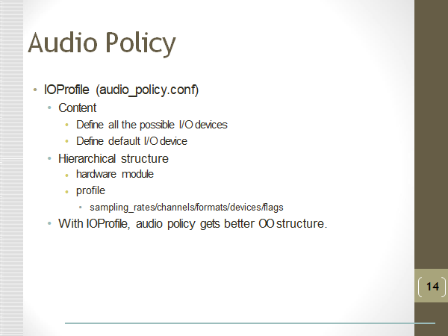

Slide 11
The top-level structure contains modules that correspond to each audio HAL hardware module, where each module has a list of mix ports, device ports, and routes:
Mix ports describe the possible config profiles for streams that can be opened at the audio HAL for playback and capture.
Device ports describe the devices that can be attached with their type (and optionally address and audio properties, if relevant).
Routes is separated from the mix port descriptor, enabling the description of routes from device to device or stream to device.
Volume tables are simple lists of points defining the curve used to translate from a UI index to a volume in dB. A separate include file provides default curves, but each curve for a given use case and device category can be overwritten.

Slide 12
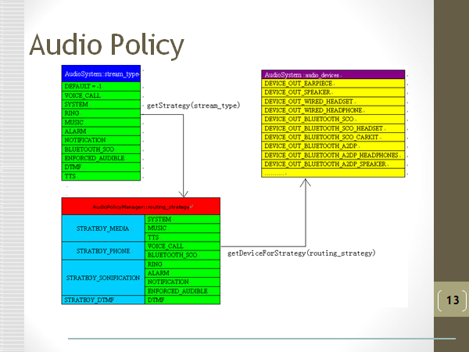

Slide 13
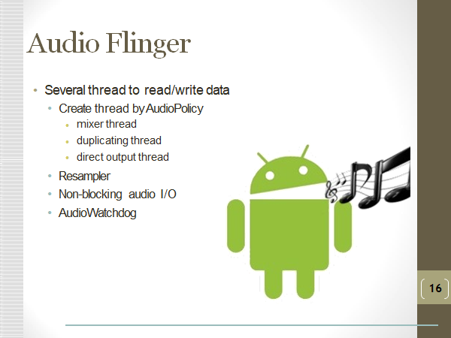
Media server The Audio Flinger The media server contains audio services, which are the actual code that interacts with your HAL implementations. The media server is located in the path: frameworks/av/services/audioflinger This media server service can be launched in init.rc file using below command. service media /system/bin/mediaserver

Slide 14
The main service interfaces provided by AudioFlinger are as follows:
sampleRate : Get the sampling rate of the hardware device format Get the audio format of the hardware device
frameCount : Get the number of periodic frames of the hardware device latency Get the transmission delay of the hardware device.
setMasterVolume : Adjust the volume of the main output device setMasterMute Mute main output device
4. setStreamVolume : Adjust the volume of the specified type of audio stream, this adjustment does not affect the volume of other types of audio streams
5. setStreamMute : Mute the specified type of audio stream setVoiceVolume Adjust the call volume
7. setMicMute : Silent microphone input setMode Switch audio mode: There are 4 audio modes, Normal, Ringtone, Call, Communication.
8. setParameters : Set the audio parameters: call the corresponding interface of the HAL layer, which is often used to switch audio channels.

Slide 15
9. getParameters : Get audio parameters: call the corresponding interface of the HAL layer
10. openOutput : Open the output stream: open the output stream device and create a PlaybackThread object
11. closeOutput : Close the output stream: remove and destroy all the tracks that are hanging on the PlaybackThread. Exit PlaybackThread and close the output stream device
12. openInput : Open the input stream: open the input stream device and create a RecordThread object
13. closeInput : Close the input stream: Exit RecordThread, close the input stream device
14.createTrack : Create a new output stream management object: Find the corresponding PlaybackThread,Create an output stream management object Track, then create and return a proxy object for that Track TrackHandle
15. openRecord : Create a new input stream management object: find the RecordThread, Create an input stream management object RecordTrack, then create and return the proxy object of the RecordTrack RecordHandle

Slide 16
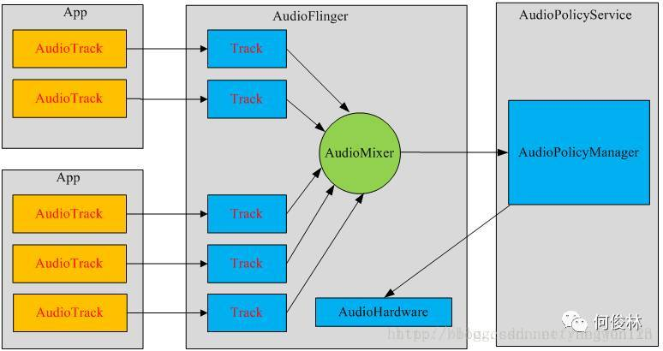

Slide 17
AudioPolicyService starts with all the audio interfaces supported by the system and opens the default audio output. When the audio output is turned on, the AudioFlinger::openOutput() function is called to create a PlaybackThread thread for the currently open audio output interface.
This thread allocates a globally unique audioiohandleThe t value is stored as a key-value pair in the member variable mPlaybackThreads of AudioFlinger. Here, firstly, according to the audio parameters, the PlaybackThread thread id number of the current audio output interface is obtained by calling the AudioSystem::getOutput() function, and is also passed to the createTrack function for creating the Track. AudioTrack is managed by Track in AudioFlinger.
However, because they are cross-process relationships, they need a "bridge" to maintain. The medium of communication is IAudioTrack. Function createTrackl In addition to AudioTrack apply for a Track in AudioFlinger in, it will also build a bridge between the two IAudioTrack.

Slide 18
The Audio HAL
Android’s audio Hardware Abstraction Layer (HAL) connects the higher-level,
audio-specific framework APIs in android.media to the underlying audio driver and hardware.
The audio HAL interfaces are located
inhardware/libhardware/include/hardware.
This section explains how to implement the audio Hardware Abstraction Layer (HAL) for different
hard wares.The audio HAL mainly contain two interfaces,
1.hardware/libhardware/include/hardware/audio.h. Represents the main functions of an audio device.
2.hardware/libhardware/include/hardware/audio_effect.h. Represents effects that can
be applied to audio such as downmixing, echo cancellation, or noise suppression.
Device vendor must implement all interfaces to support audio HAL.

Slide 19
Audio Hardware mainly contains basic functionality for:
Opening/closing audio input/output streams
Audio devices enabling/disabling, like EARPIECE, SPEAKER, and BLUETOOTH_SCO, etc.
Set volume for voice call and Mute Mic.
In the hal layer, all types of hardware are described in the form of hardware modules.
hw_module_t structure, and each type of hardware module has its own independent hardware.
The hal uses the hw_device_t structure. Body to describe.
The hw_module_t struct contains a pointer to another struct, hw_module_methods_t, that contains a pointer to an open function for the module. This open function is used to initiate communication with the hardware for which the HAL is serving as an abstraction.
Each type of device defines a detailed version of the generic hw_device_t that contains function pointers for specific features of the hardware. For example, the audio_hw_device_t struct type contains function pointers to audio device operations:

Slide 20
From the Audio HAL, we usually see the following four output stream devices, which correspond to different playback scenarios:
primary_out: Main output stream device for ringtone sound output, corresponds to an audio stream identified as AUDIO_OUTPUT_FLAG_PRIMARY and a MixerThread playback thread instance
low_latency: Low-latency output stream device for sound output with high latency, such as button tones, game background sounds, etc. corresponds to the audio stream identified as AUDIO_OUTPUT_FLAG_FAST and a MixerThread playback thread instance
deep_buffer: music track output stream device, used for sound output such as music that does not require high latency. corresponds to the audio stream identified as AUDIO_OUTPUT_FLAG_DEEP_BUFFER and a MixerThread playback thread instance
compress_offload: Hard solution output stream device for data output requiring hardware decoding, corresponds to the audio stream identified as AUDIO_OUTPUT_FLAG_COMPRESS_OFFLOAD and an OffloadThread playback thread instance

Slide 21
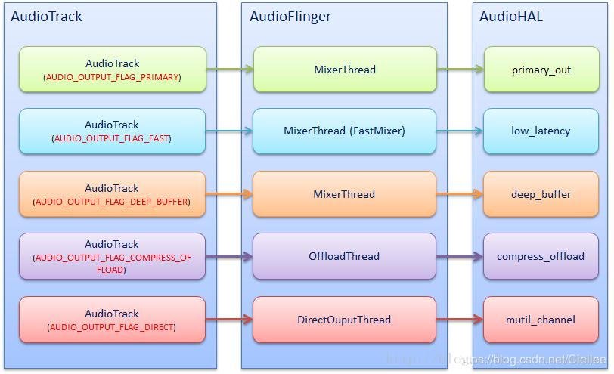

Slide 22
NU player to HAL
1.NuPlayer gets the file format metadata based on the type created by the source parser and decoder.
For compress offload, DecoderPassThrough is created, causing the software decoder to enter Passthrough mode and not perform decoding.
2. NuPlayer calls CanOffloadStream, which in turn calls the APM API isOffloadSupported to decide if a stream can be offloaded.
3. NuPlayer creates a new NuPlayerRenderer, which then creates a new AudioTrack.
Based on the information NuPlayer has received from the APM, it sets the flag FLAG_OFFLOAD_AUDIO, which passes to NuPlayerRenderer.
4. AudioTrack then calls getOutput(), which gets the profile information from the APM.
The APM then calls openOutput(), which goes to AudioFlinger.
Based on the AUDIO_OUTPUT_FLAG_COMPRESS_OFFLOAD flag previously set by AudioPlayer,
AudioFlinger creates the offload thread.
AudioFlinger also calls open_output_stream() which goes to the HAL.
The HAL then creates the offload callback thread used to notify the write and drain completion events.

Slide 23
NU player to HAL
5. AudioTrack creates the track to be used for this stream.
6. NuPlayerRenderer issues a start command to AudioSink, which then calls start_output_stream().
The HAL sends the appropriate mixer control to the back-end (BE) platform driver to configure the output device.
7. The HAL opens the compress driver and sends the codec and stream parameters to the compress driver though the IOCTL SNDRV_COMPRESS_SET_PARAMS.
The compress driver opens an ASM session accordingly and requests the ASM driver to allocate the buffers to be used for this session.

Slide 24
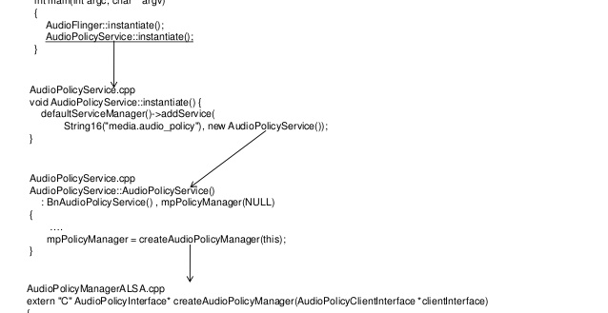

Slide 25
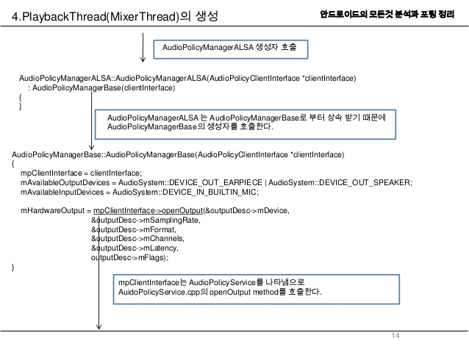

Slide 26
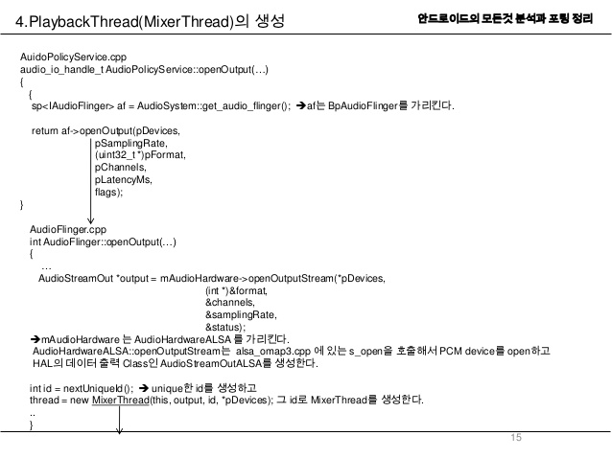

Slide 27
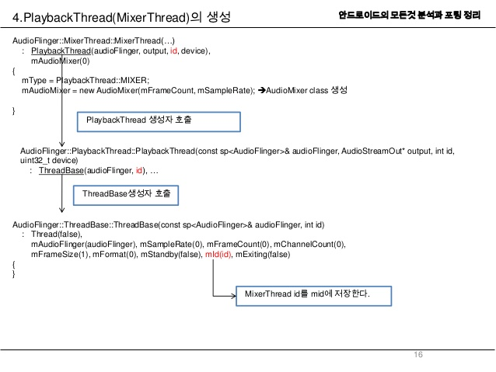

Slide 28
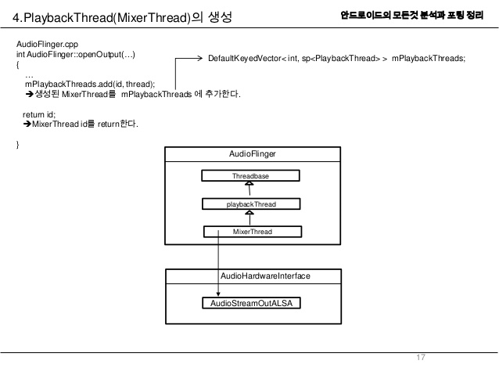

Slide 29
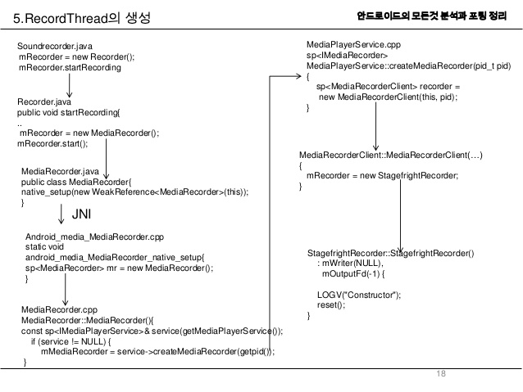

Slide 30
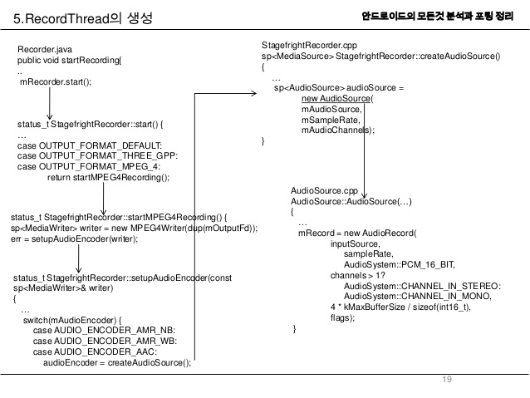

Slide 31
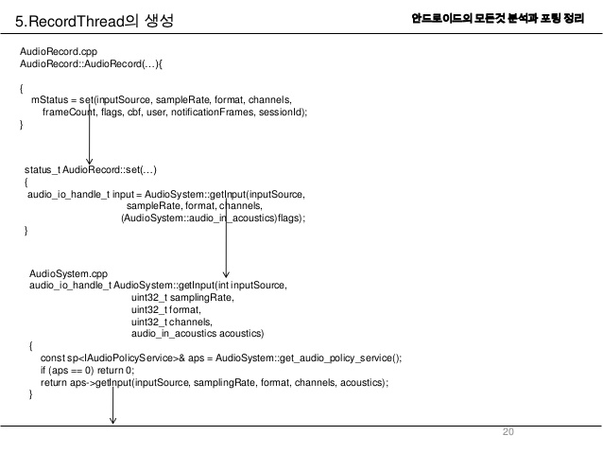

Slide 32
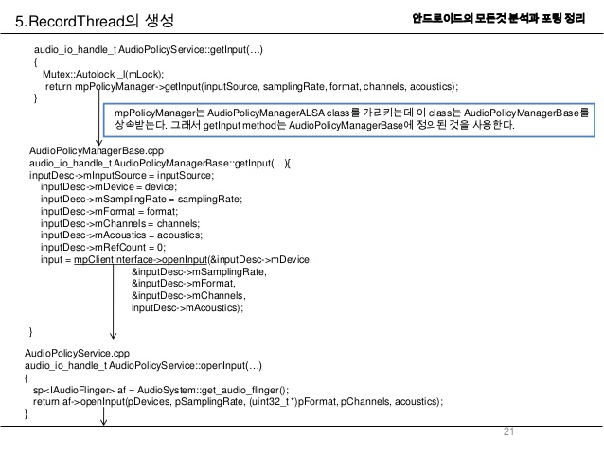

Slide 33
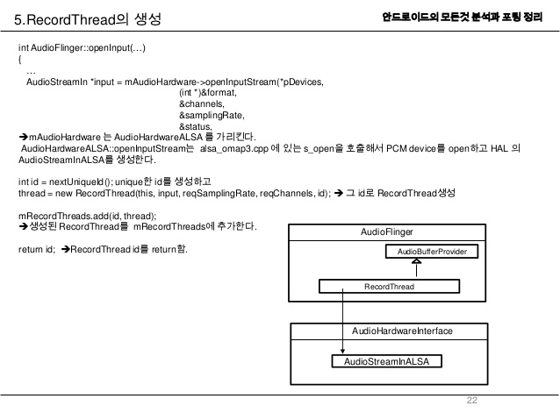

Slide 34
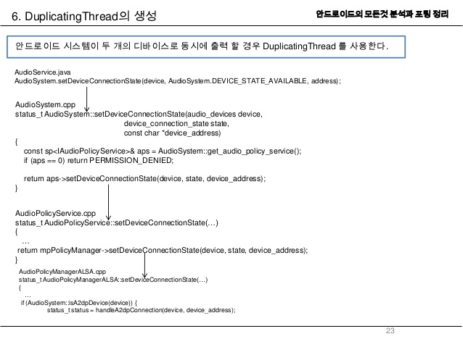

Slide 35
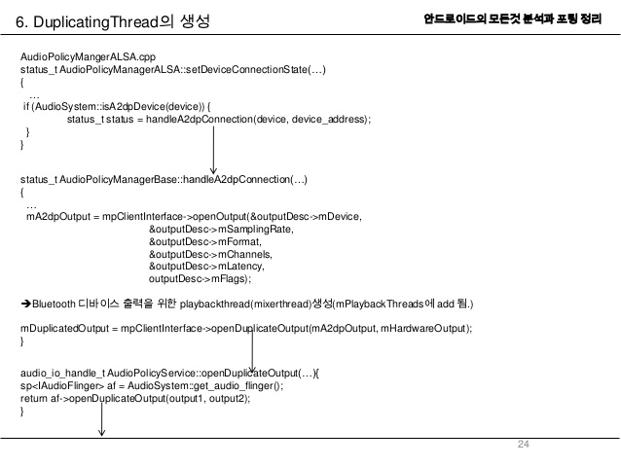

Slide 36
